Slide 1
0904
John

Slide 2
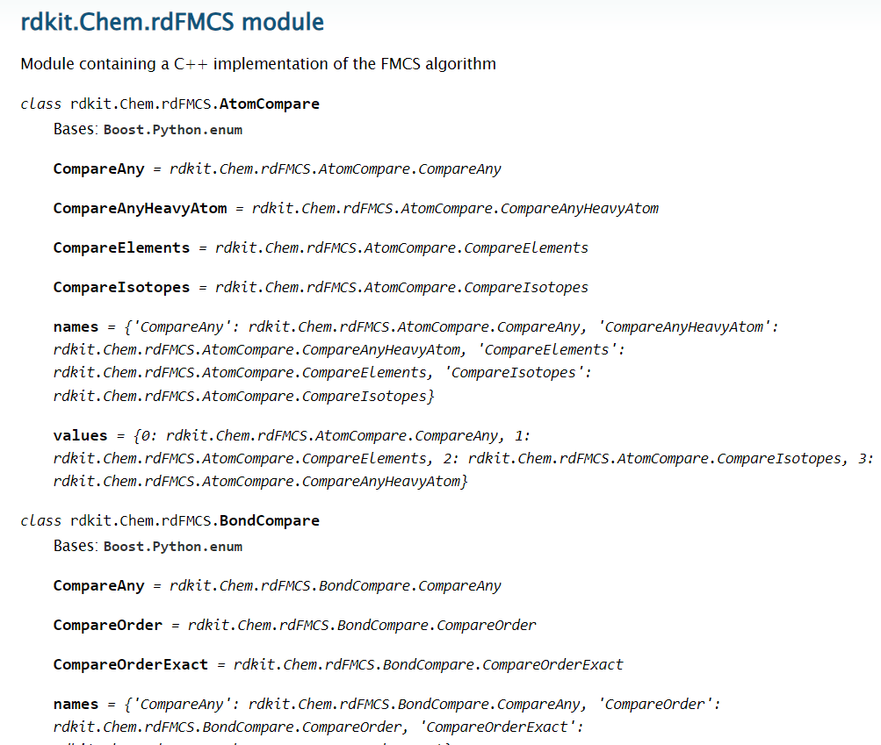
Maximum Common Substructure(MCS)
Ring Parameters:
CompleteRingsOnly:
results cannot include lone ring atoms
RingMatchesRingOnly:
ring atoms are only allowed to match other ring atoms

Slide 3
Pipeline
K-means/ HDBSCAN/K-medoids result has been complete
Find *MCS
Potential reason of poor perdition
Evaluation
WWL distance kernel
(using DMPNN model input feature as input)
Clustering
DMPNN featurizer
Compound
(SMILES)
augmentation
Even class training
Might improve results?
On-going
DMPNN featurizer
oversampling
Model ensemble
DMPNN Model
Regression model
complete
*MCS: Maximum Common Substructure(MCS)

Slide 4
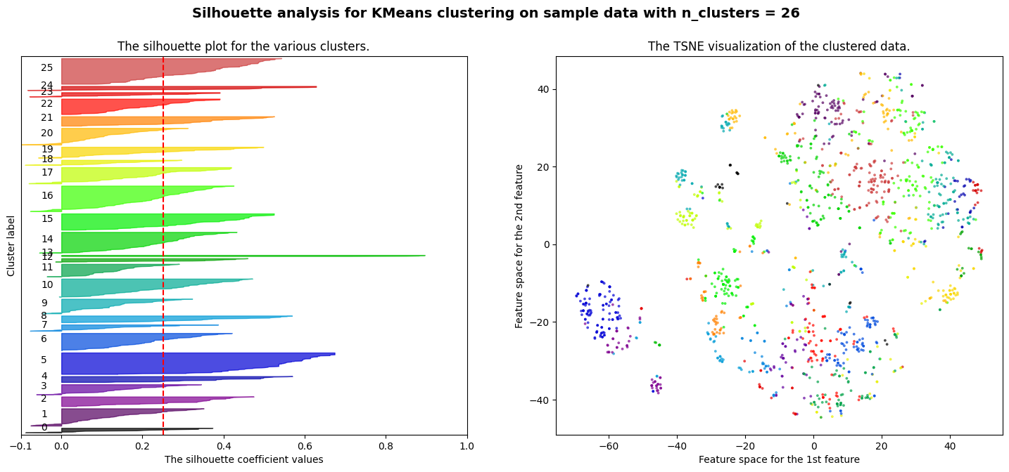
K-means, n_cluster=26

Slide 5
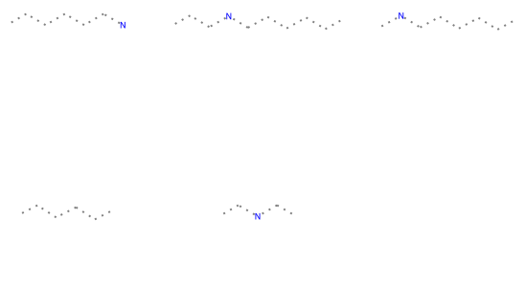
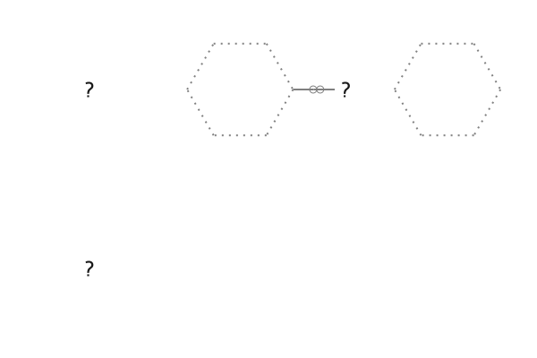
Cluster_id
0 | 1 | 2 | 3 | 4 | 5 | 6 | 7 | 8 | 9 | 10 | 11 | 12
23 | 84 | 47 | 49 | 29 | 104 | 84 | 31 | 33 | 71 | 87 | 61 | 17
Cluster_size
13 | 14 | 15 | 16 | 17 | 18 | 19 | 20 | 21 | 22 | 23 | 24 | 25
6 | 101 | 79 | 124 | 79 | 25 | 53 | 81 | 46 | 75 | 21 | 20 | 124
Ring Parameters=False
Ring Parameters= true
Notes:
MCS1 contains 1 atoms and 0 bonds.
MCS SMARTS string: [#7&!R]
False
MCS1 contains 7 atoms and 7 bonds.
MCS SMARTS string: [#6&!R]-&!@[#6&R]1:,-;@[#6&R]:,-;@[#6&R]:,-;@[#6&R]:,-;@[#6&R]:,-;@[#6&R]:,-;@1
False
MCS1 contains 6 atoms and 6 bonds.
MCS SMARTS string: [#6&R]1:,-;@[#6&R]:,-;@[#6&R]:,-;@[#6&R]:,-;@[#6&R]:,-;@[#6&R]:,-;@1
False
MCS1 contains 1 atoms and 0 bonds.
MCS SMARTS string: [#16&!R]
False
MCS1 contains 0 atoms and 0 bonds.

Slide 6
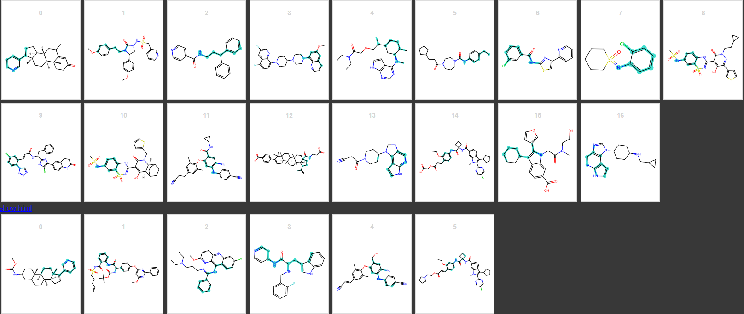

Slide 7
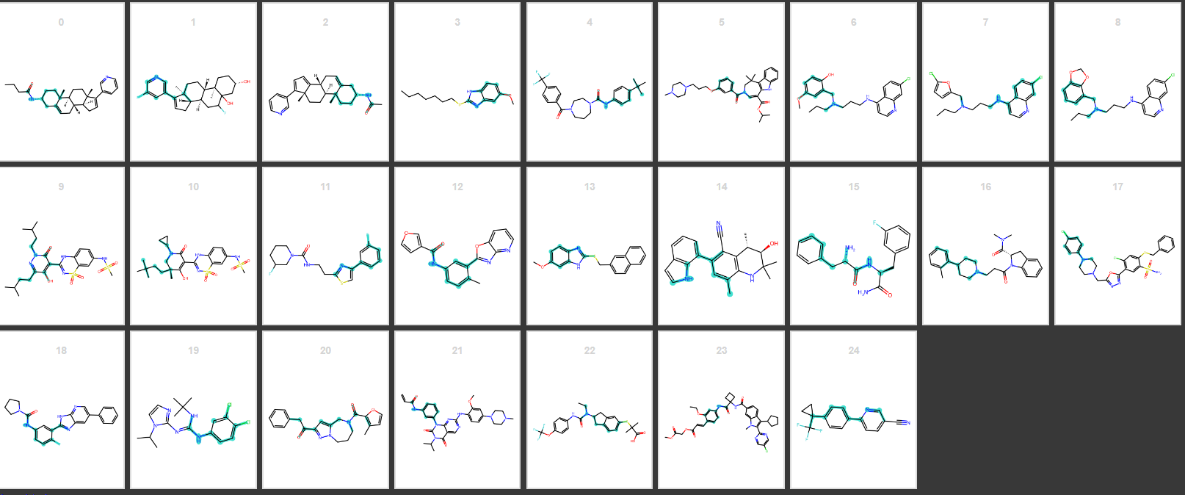

Slide 8
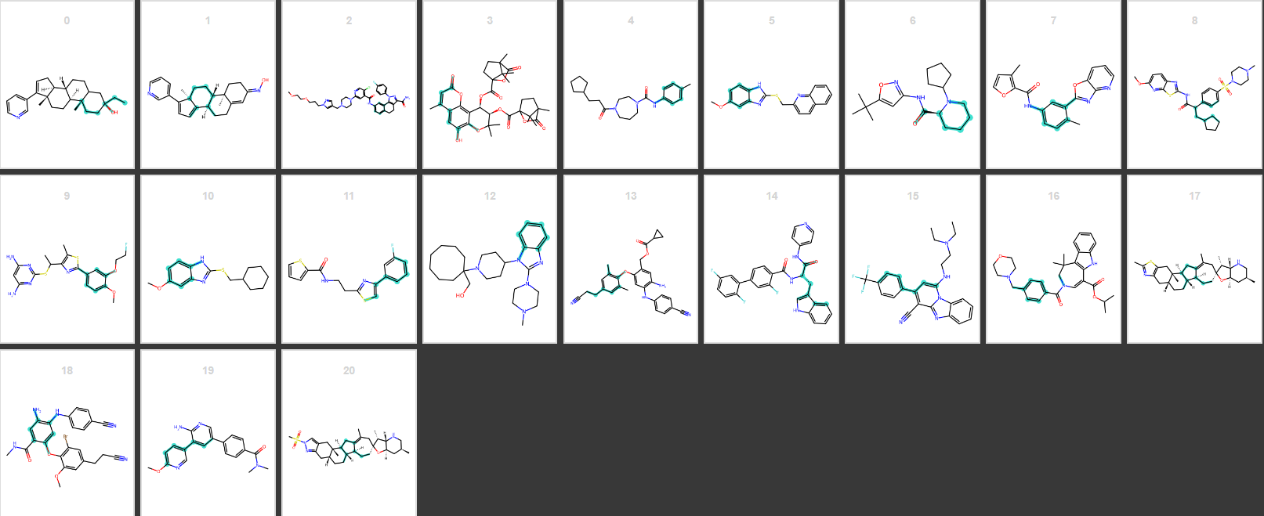

Slide 9
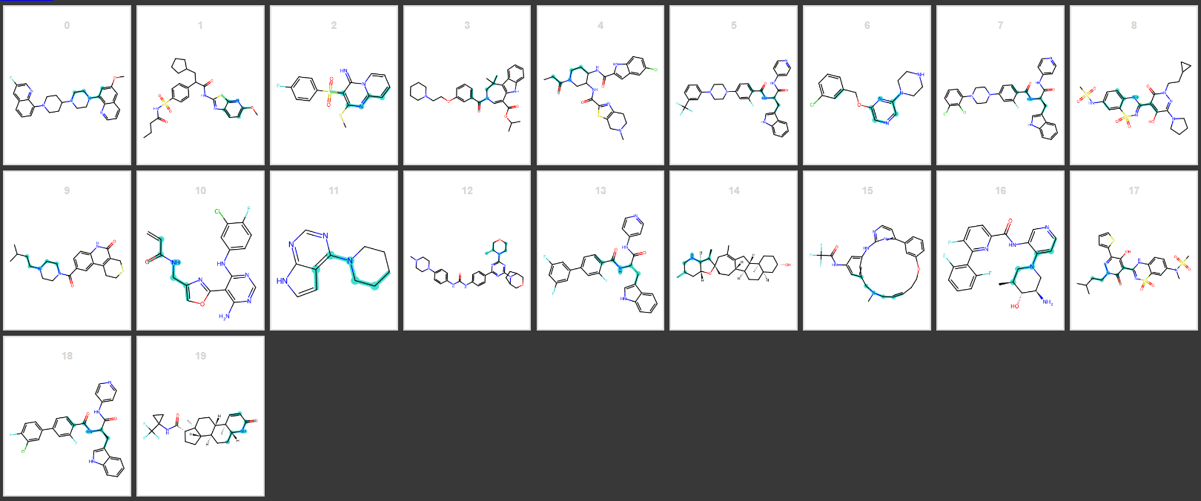

Slide 10
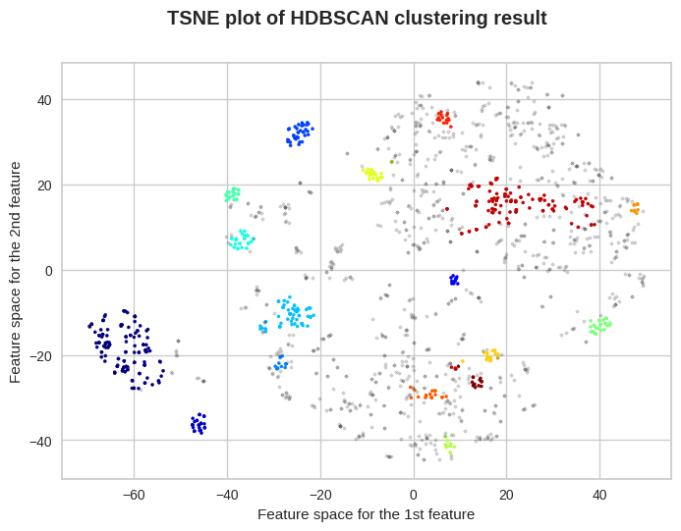
HDBSCAN, min_cluster_size=10
*Gray point as outlier

Slide 11
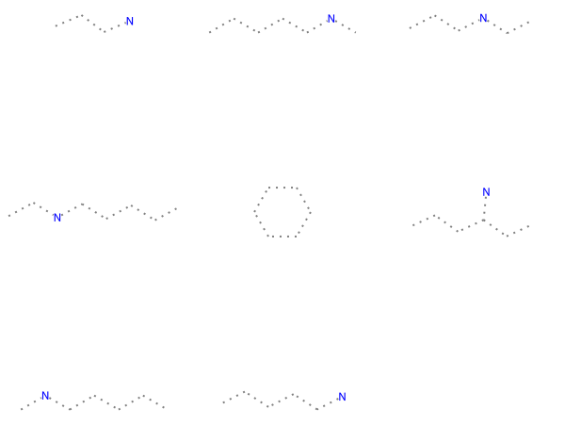
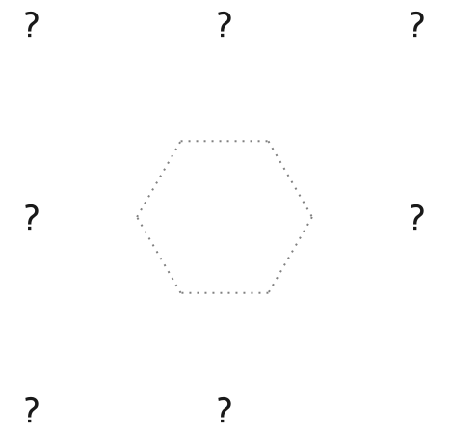
*Label -1 as outlier
Cluster_id
-1 | 0 | 1 | 2 | 3 | 4 | 5 | 6 | 7 | 8 | 9 | 10 | 11 | 12 | 13 | 14 | 15 | 16
993 | 126 | 25 | 11 | 35 | 11 | 55 | 27 | 20 | 25 | 13 | 31 | 16 | 11 | 18 | 15 | 118 | 14
Cluster_size
Ring Parameters=False
Ring Parameters= true

Slide 12
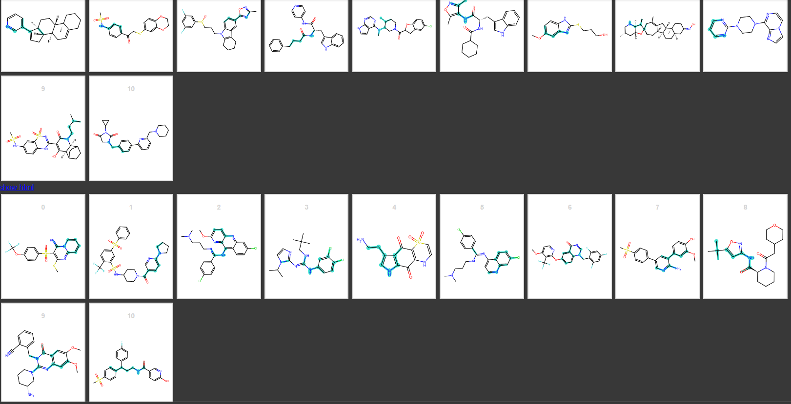

Slide 13
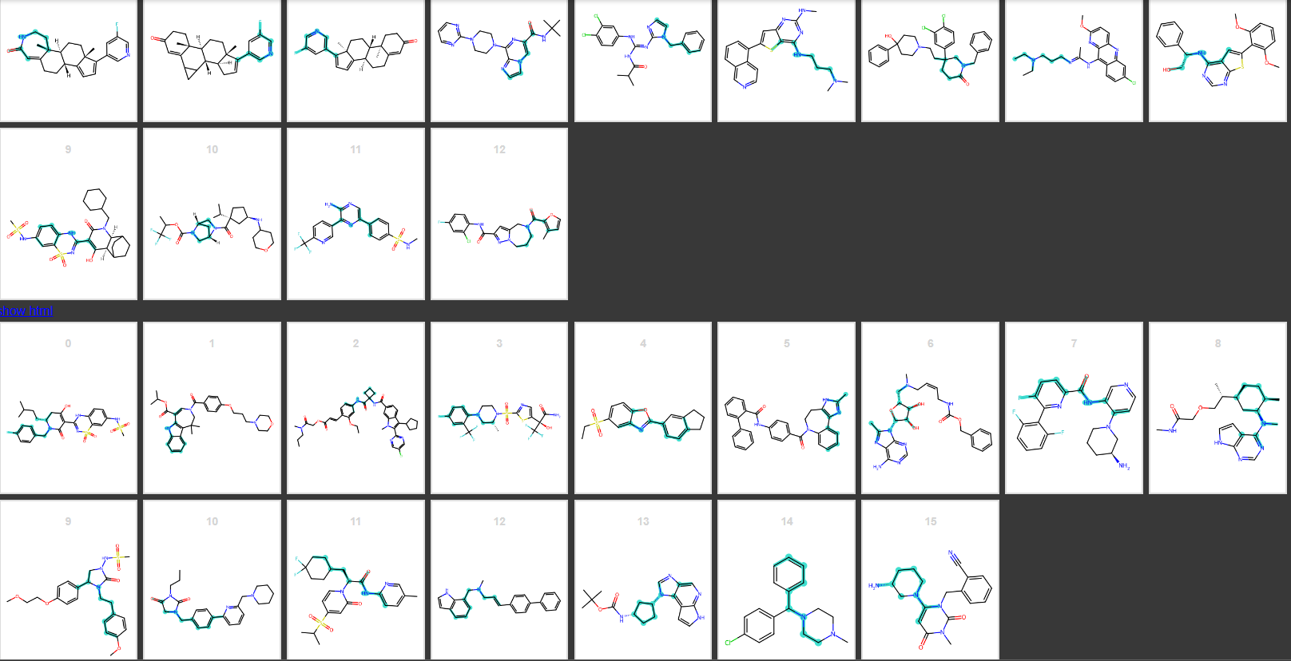

Slide 14
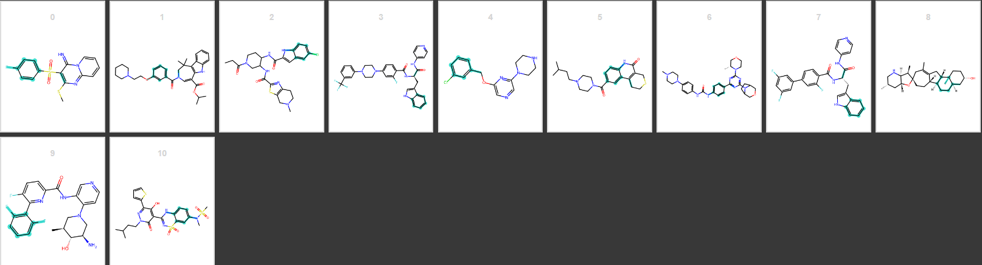
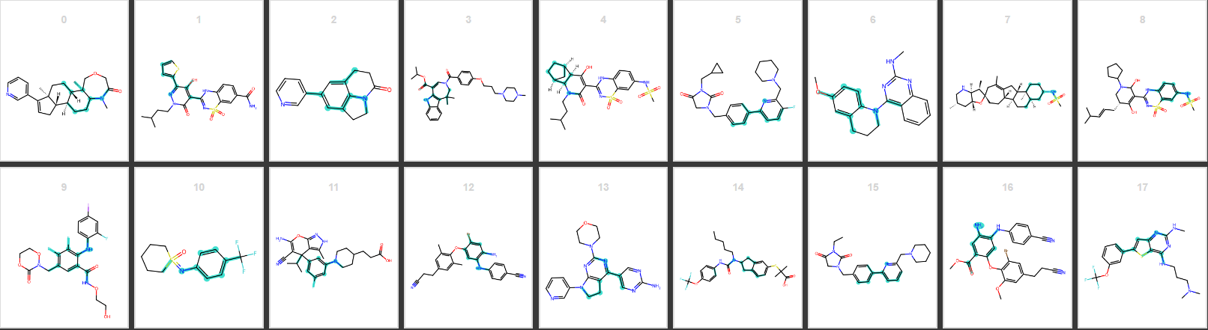

Slide 15
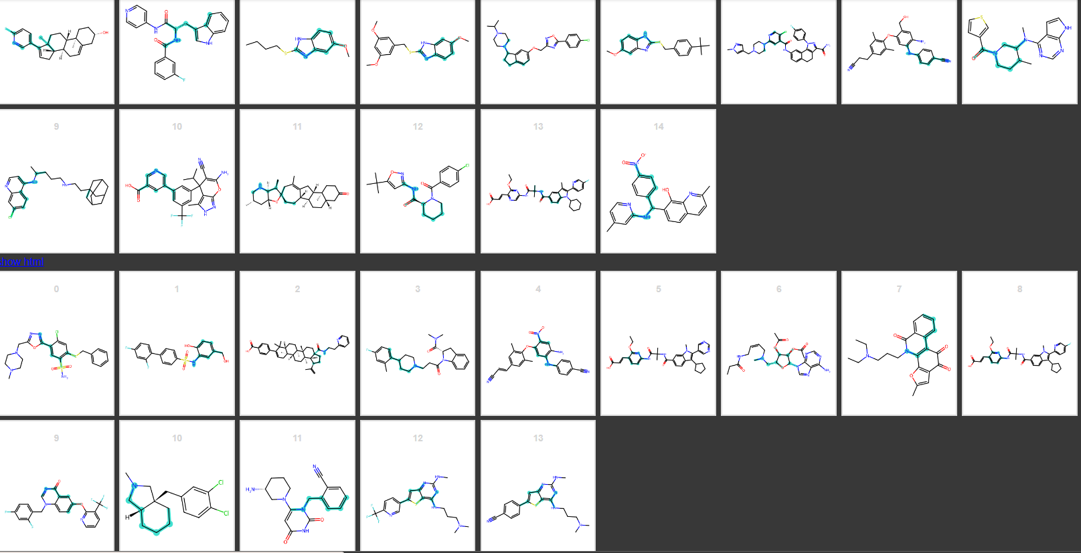

Slide 16
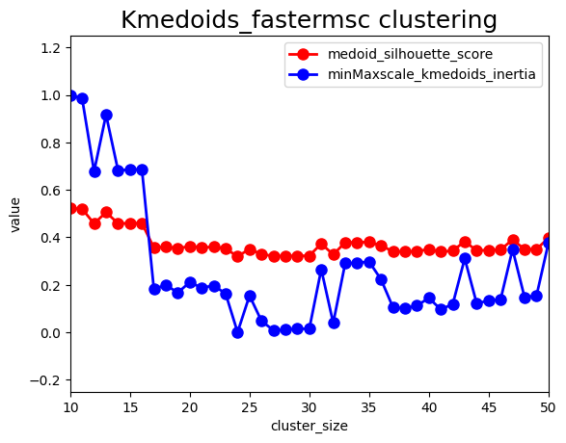
K-medoids, n_cluster=17

Slide 17
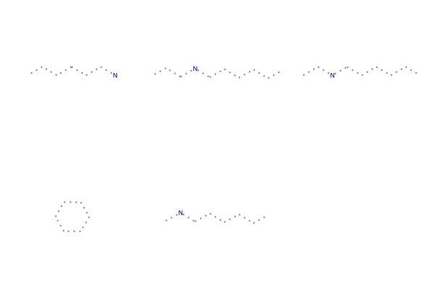
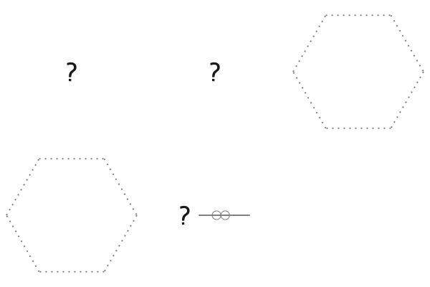
*Label -1 as outlier
Cluster_id
0 | 1 | 2 | 3 | 4 | 5 | 6 | 7 | 8 | 9 | 10 | 11 | 12 | 13 | 14 | 15 | 16
12 | 231 | 27 | 199 | 53 | 6 | 83 | 11 | 476 | 132 | 23 | 58 | 15 | 167 | 8 | 18 | 35
Cluster_size
Ring Parameters=False
Ring Parameters= true

Slide 18
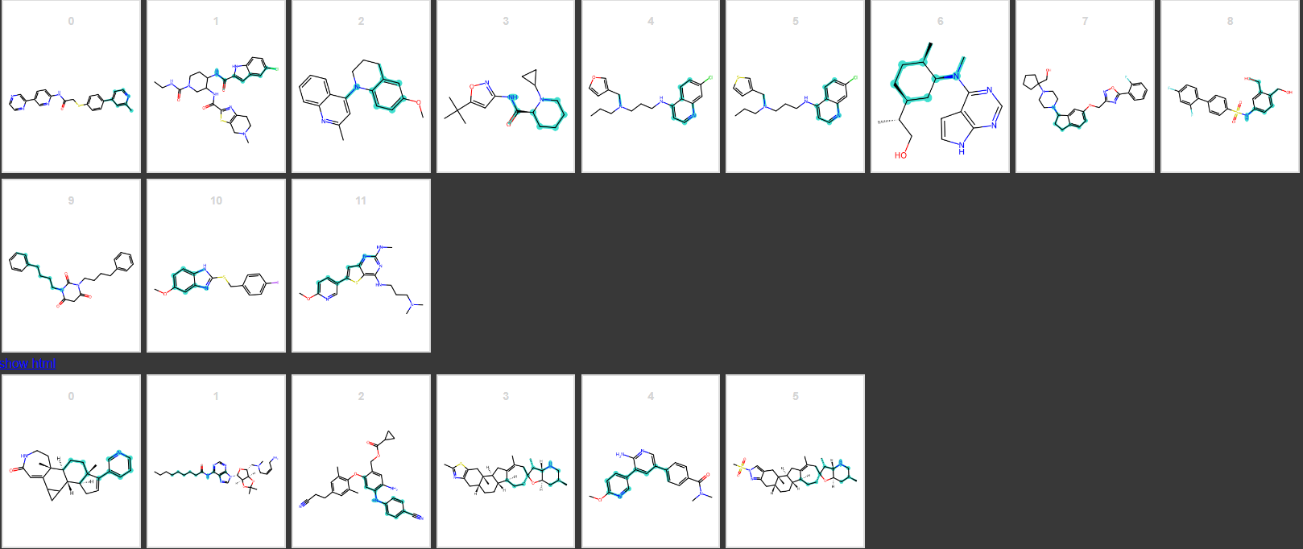

Slide 19
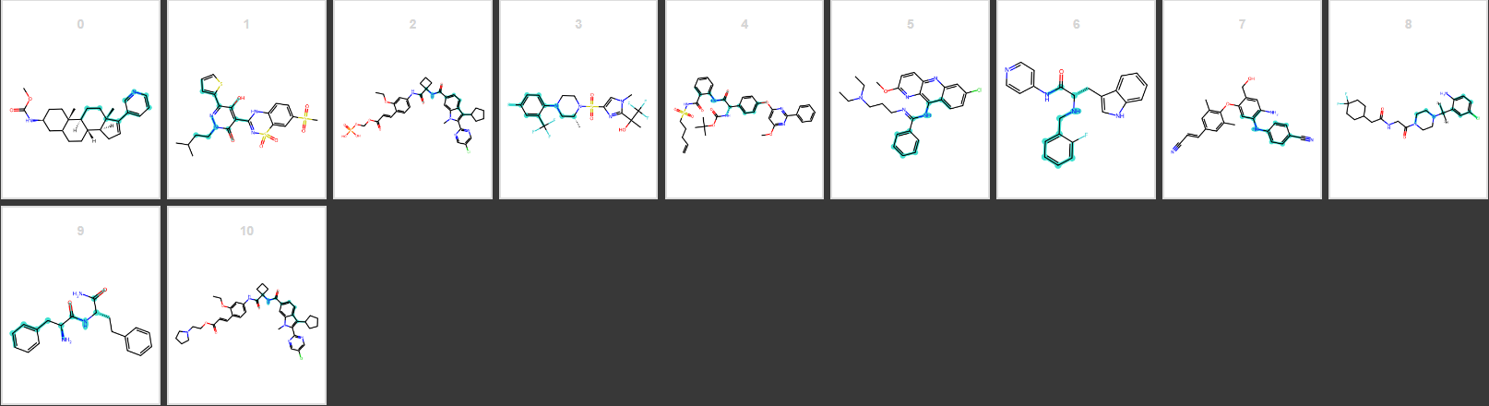

Slide 20
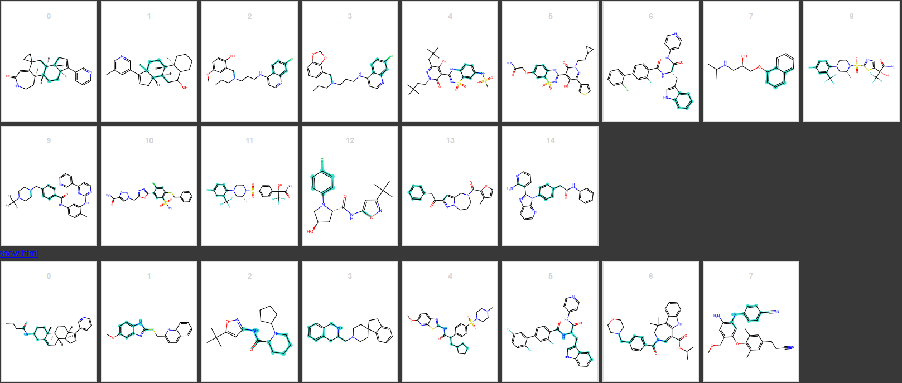

Slide 21
(with WWL kernel calculated distance matrix)
datasets
(After clustering, now can Use cluster info. as label)
(Total:1554)
deepchem.splits.splitters.RandomSplitter(seed)
StratifiedShuffleSplit(n_splits=2, test_size=0.1, seed)
(Train: test = 9 :1)
Train-sets & test-sets
RandomOverSampler(random_state=42)
(the size of each cluster is the same)
deepchem.splits.splitters.RandomSplitter(seed).k_fold_split()
Oversampled train-set
deepchem.splits.splitters.RandomSplitter(seed).k_fold_split()
5-fold_dataset
train/ validate/ test

Slide 22
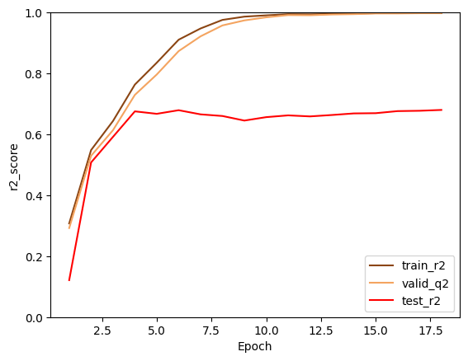
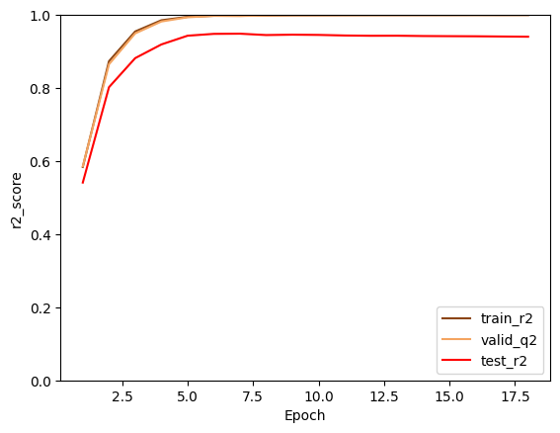
r2
Random_oversampling
Train: 0.997921116899646
Valid: 0.9975195684287266
Test: 0.6800138961510643
Train: 0.9975659978968008
Valid: 0.9971689674308697
Test: 0.9487280626833897

Slide 23
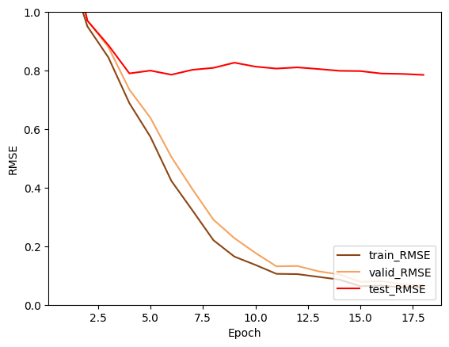
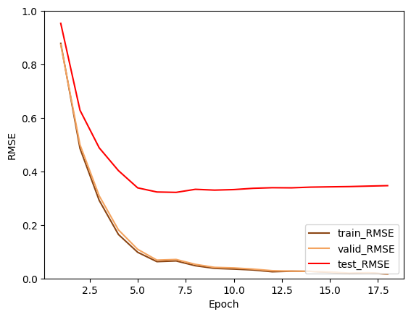
RMSE
Random_oversampling
Train: 0.06069286312352816
Valid 0.06754575170276078
Test: 0.7851467917524932
Train:0.06545657930001297
Valid: 0.07094728474141729
Test: 0.32177897087096674

